Slide 1
Biodiversity in National Parks
An analysis of biodiversity data about endangered species observed in different national parks in the USA

Slide 2
Description of the Data
The data for this project was provided by Codecademy.com
The data was distributed in two different files (species_info.csv & observations.csv)
The file named species_info.csv contains the following variables:
category - class of animal (Mammal, Bird, Amphibian, Fish, Vascular Plant or Nonvascular Plant)
scientific_name - The global scientific name of each species
common_name - the common name of each species
conservation_status - each species’ current conservation status
The file named observations.csv contains the following variables:
scientific_name - see explanation above
park_name - park where species found (Yellowstone, Yosemite, Bryce or Great Smoky Mountains national park)
observations - recorded sightings of different species during a one-week period

Slide 3
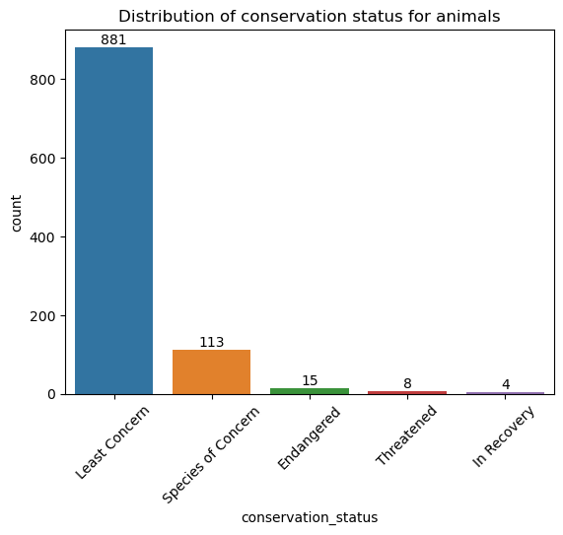
Distribution of conservation status for Animals
The dominant conservation status category for all animals is “Least Concern”, which means that the species are still plentiful in the wild.
The second largest category is “Species of Concern”, which means that the species could easily become endangered or threatened.

Slide 4
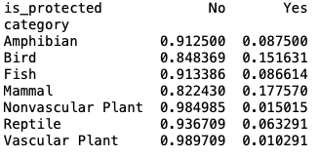
Are certain types of species more likely to be endangered?
Birds and Mammals are more likely to be endangered (15.16% and 17.76% respectively are being under protection).
Recommendation: more resources need to be committed in order to improve the conditions of Mammals and Birds
Plants have the lowest proportions of species that are protected.

Slide 5
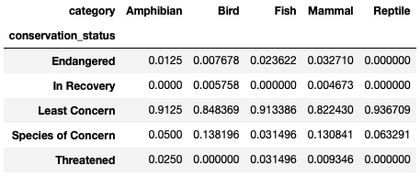
Are certain types of species more likely to be endangered? (continued)
Birds have the highest proportion of Species of Concern (13.82%). If nothing is done about the species of concern, the proportions of threatened and endangered species among Birds might increase.

Slide 6
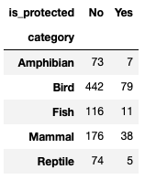
Are the differences in protection status significant?
The Chi-square test of independence of variables was performed
H0: No relation between the variables
H1: there is a significant relationship between the variables
Alpha = 5%
Chi2-Statistic: 11.93, p-value = 1.79%, dof = 4
We reject the null hypothesis
The differences in protection status between the listed animal categories are significant

Slide 7
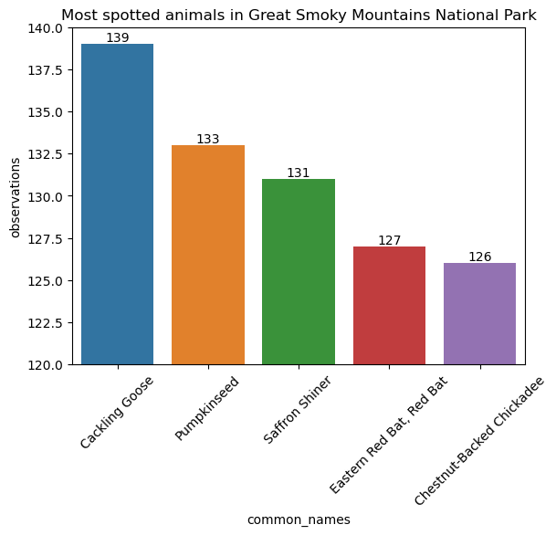
Most spotted animals in Great Smoky Mountains National Park
The cackling goose was the most spotted animal species.

Slide 8
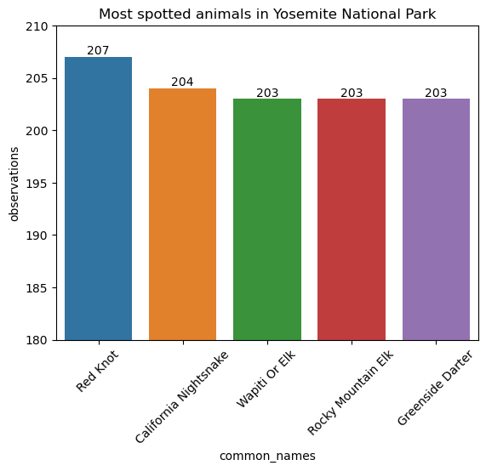
Most spotted animals in Yosemite National Park
The most spotted animal species was a bird called Red Knot

Slide 9
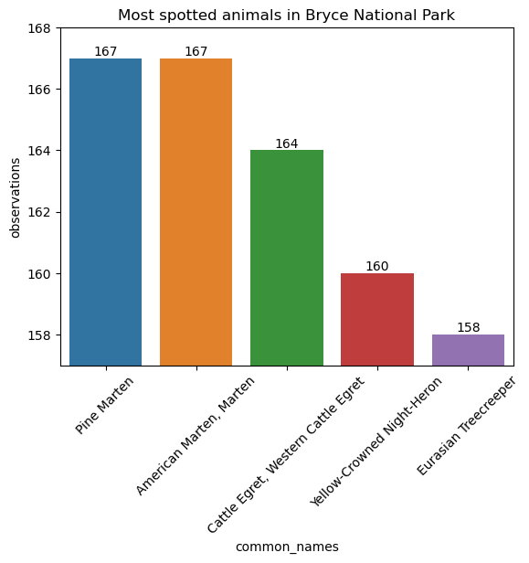
Most spotted animals in Bryce National Park
The two most spotted animal species were two different types of martens

Slide 10
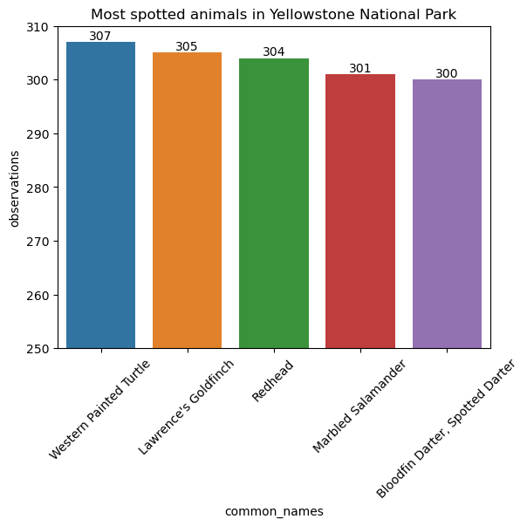
Most spotted animals in Yellowstone National Park
The most spotted animal species was the western painted turtle.

